Slide 1
Basic Structure of C Programming
Prepared By:
Asst. Prof. Jyotsnarani Tripathy

Slide 2
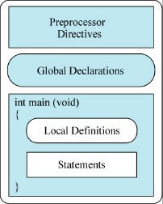
Structure of a C Program

Slide 3
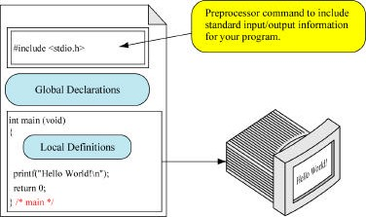
First Program

Slide 4
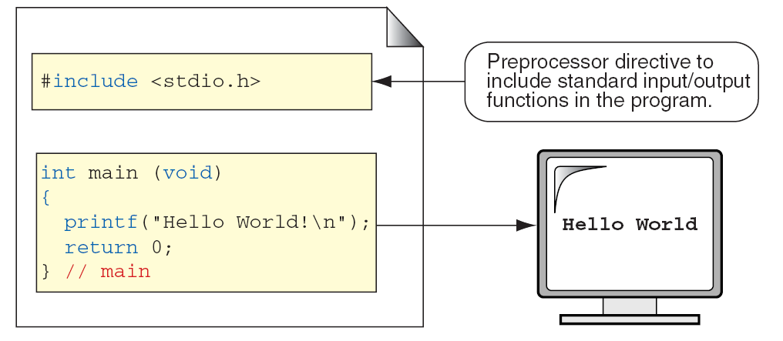

Slide 5
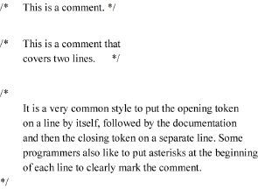
Comments

Slide 6
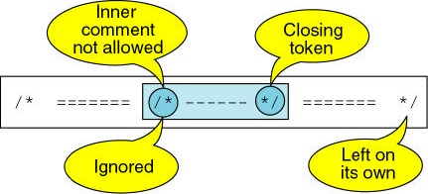
Comments

Slide 7
Pre-processor Directives
Preprocessor directives start with # #include copies a file into the source code
#include <systemFilename> #include “undefinedFilename”

Slide 8
#include <stdio.h>
stdio.h is the standard input/output header
.h files are header files
Header files contain definitions

Slide 9
The main() function
Programs must have a main() function:
Two allowed formats:
int main( void ) int main(int argc,
char *argv[])

Slide 10
First Program

Slide 11
Variables
A variable is a block of memory that stores data of a particular type and is named with an appropriate identifier.
An int number_of_days might begin at A000
The int is 4 bytes:
A000 | 10101001
A001 | 00000000
A002 | 10101010
A003 | 11110010

Slide 12
Variables
The name of the variable corresponds to the address of the first byte!
The machine remembers the address and knows that an int is four bytes
Knowing the address is very important in C

Slide 13
Rules for Naming Variables
First character: alphabetic or underscore
Consist only of alphanumeric or underscores
Only first 31 characters count
Cannot duplicate a reserved word

Slide 14
Legal/Illegal Names
Legal | Illegal
a | $sum
student_name | 2names
TRUE | stdnt number
FALSE | int

Slide 15
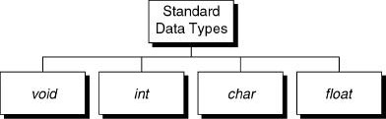
Standard Data Types

Slide 16
Primitive Data Types
Data Type | C-Implementation
void | void
character | char (1 byte)
integer | unsigned short int (1 byte) unsigned int (2 or 4 bytes) unsigned long int (4 or 8 bytes)
 | short int (1 byte) int (2 or 4 bytes) long int (4 or 8 bytes)
floating point | float (4 bytes) double (8 bytes) long double (10 bytes)

Slide 17
Logical Data
No Boolean data type!!
In C:
any nonzero number is true
zero is false

Slide 18
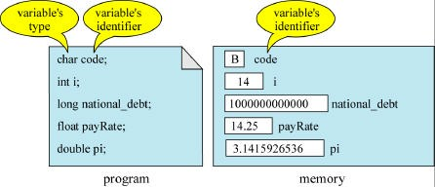
Variable Declaration

Slide 19
Variable Initialization
No variable is initialized until you do so!
char code = ‘B’; int i = 0;
long national_debt = 2931000001L; unsigned long gnp = 332000101LU; float aVariable = 3.1415f;
double variable2 = 3.1415926535;
long double variable3 = 3.14159265358979L;

Slide 20
Special Characters
ASCII Character | Symbolic Name
Null character ’\0’ Alert (bell) ’\a’ Backspace ’\b’ Horizontal tab ’\t’ Newline ’\n’ Vertical Tab ’\v’

Slide 21
Special Characters
ASCII Character | Symbolic Name
Form Feed ’\f’ Carriage return ’\r’ Single quote ’\’’ Double Quote ’\”’ Backslash ’\\’

Slide 22
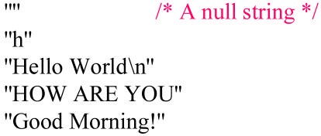
String Constants

Slide 23
#define
#define name token(s)
Replaces the name with the token(s)
Example:
#define PI 3.1415926535
#define SIZE 1000

Slide 24
#define
No equals sign
No semicolon
Multiple lines require \ at end of line

Slide 25
Constants
To define a constant define a variable with:
const
Works:
const float pi = 3.1415926;
Doesn’t:
const float pi;
pi=3.1415926; /* not allowed to change it */

Slide 26
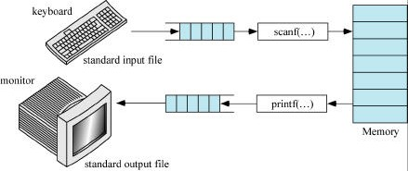
Standard Input and Output

Slide 27
A Simple C Program: Printing a Line of Text
A left brace, {, begins the body of every function .
A corresponding right brace ends each function .
This pair of braces and the portion of the program between the braces is called a block.
printf( "Welcome to C!\n" );
instructs the computer to perform an action, namely to print on the screen the string of characters marked by the quotation marks.
A string is sometimes called a character string, a message or a literal.

Slide 28
2.2 A Simple C Program: Printing a Line of Text (Cont.)
The entire line, including printf, its argument within the parentheses and the semicolon (;), is called a statement.
Every statement must end with a semicolon (also known as the statement terminator).
When the preceding printf statement is executed, it prints the message Welcome to C! on the screen.
The characters normally print exactly as they appear between the double quotes in the printf statement.
Notice that the characters \n were not printed on the screen.
The backslash (\) is called an escape character.
It indicates that printf is supposed to do something out of the ordinary.

Slide 29
A Simple C Program: Printing a Line of Text (Cont.)
When encountering a backslash in a string, the compiler looks ahead at the next character and combines it with the backslash to form an escape sequence.
The escape sequence \n means newline.
When a newline appears in the string output by a printf, the newline causes the cursor to position to the beginning of the next line on the screen.
Some common escape sequences are listed in Fig. 2.2.

Slide 30
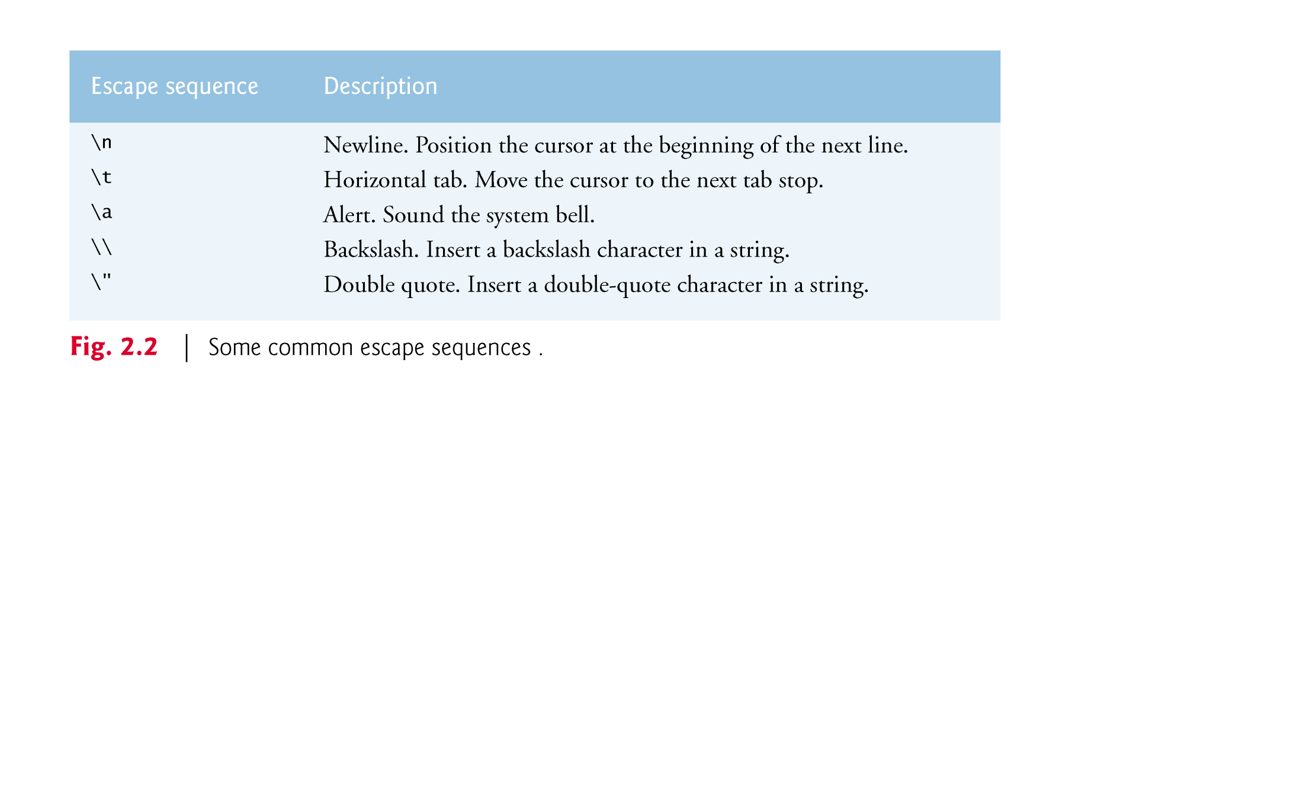

Slide 31
A Simple C Program: Printing a Line of Text (Cont.)
    return 0; /* indicate that program ended successfully */
is included at the end of every main function.
The keyword return is one of several means we’ll use to exit a function.
When the return statement is used at the end of main as shown here, the value 0 indicates that the program has terminated successfully.
The right brace, }, indicates that the end of main has been reached.

Slide 32
Format Specifier
%d Integer Format Specifier
%f Float Format Specifier
%c Character Format Specifier
%s String Format Specifier
%u Unsigned Integer Format Specifier
%ld Long Int Format Specifier

Slide 33
Program to Display "Hello, World!"
#include <stdio.h>
int main() {
// printf() displays the string inside quotation
printf("Hello, World!");
return 0;
}
Output
Hello, World!

Slide 34
Program to Print an Integer
#include <stdio.h>
int main() {
int number;
printf("Enter an integer: ");
// reads and stores input
scanf("%d", &number);
// displays output
printf("You entered: %d", number);
return 0;
}
Output
Enter an integer: 25 You entered: 25

Slide 35
Swap Numbers Using Temporary Variable
#include<stdio.h>
int main() {
double first, second, temp;
printf("Enter first number: ");
scanf("%lf", &first);
printf("Enter second number: ");
scanf("%lf", &second);
temp = first;
first = second;
second = temp;
printf("\nAfter swapping, firstNumber = %.2lf\n", first);
printf("After swapping, secondNumber = %.2lf", second);
return 0;
}

Slide 36
Output
Enter first number: 1.20
Enter second number: 2.45
After swapping, firstNumber = 2.45
After swapping, secondNumber = 1.20

Slide 37
Program to convert temperature from Celsius to Fahrenheit
#include <stdio.h>
int main()
{
float celsius, fahrenheit;
/* Input temperature in celsius */
printf("Enter temperature in Celsius: ");
scanf("%f", &celsius);
/* celsius to fahrenheit conversion formula */
fahrenheit = (celsius * 9 / 5) + 32;
printf("%.2f Celsius = %.2f Fahrenheit", celsius, fahrenheit);
return 0;
}
output
Enter temperature in Celsius: 100
100 Celsius = 212.00 Fahrenheit

Slide 38
Program to add two numbers
#include <stdio.h>
int main()
{
int num1, num2, sum;
/*
* Input two numbers from user
*/
printf("Enter any two numbers : ");
scanf("%d%d", &num1, &num2);
sum = num1 + num2;
/* Prints the sum of two numbers */
printf("Sum of %d and %d = %d\n", num1, num2, sum);
return 0;
}
output
Enter any two numbers : 12 20
Sum of 12 and 20 = 32

